Slide 1
Logic and computers

Slide 2
Binary Arithmetic
Only two digits: the bits 0 and 1
(Think: 0 = F, 1 = T)
0
+ 0
----
0
0
+ 1
----
1
1
+ 0
----
1
1
+ 1
----
10

Slide 3
Logic and Computers
A half adder:
Two bits in (A, B: to be added together)
Two bits out (S, C: sum and carry)
0+0=0, carry 0
0+1=1, carry 0
1+0=1, carry 0
1+1=0, carry 1
S := A⊕B
C := A∧B

Slide 4
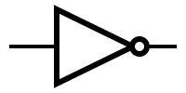
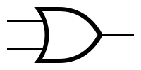

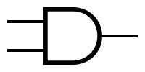
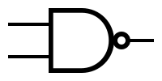
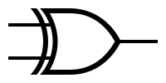

LOGIC GATES
NOT
OR NOR
AND NAND
XOR NXOR
(EQUIV)

Slide 5
Logic and Computers
S := A⊕B
C := A∧B
A
S
B
C

Slide 6
Half Adder
A
S
B
C
HA
A S
B C

Slide 7
A Longer Addition
1
1
11
+ 11
1
1
0

Slide 8
Full Adder
Need a third input to create a component of a ripple-carry adder: the carry from the previous bit position
Inputs: A, B, C_{in}
Outputs: S, C_{out}
A | B | C_{in} | S | C_{out}
0 | 0 | 0 | 0 | 0
0 | 0 | 1 | 1 | 0
0 | 1 | 0 | 1 | 0
0 | 1 | 1 | 0 | 1
1 | 0 | 0 | 1 | 0
1 | 0 | 1 | 0 | 1
1 | 1 | 0 | 0 | 1
1 | 1 | 1 | 1 | 1

Slide 9
Full Adder
A | B | C_{in} | S | C_{out}
0 | 0 | 0 | 0 | 0
0 | 0 | 1 | 1 | 0
0 | 1 | 0 | 1 | 0
0 | 1 | 1 | 0 | 1
1 | 0 | 0 | 1 | 0
1 | 0 | 1 | 0 | 1
1 | 1 | 0 | 0 | 1
1 | 1 | 1 | 1 | 1
HA
C_{in} S
A S
B C
HA
A
B
HA
C_{out}

Slide 10
Full Adder
C_{in}
S
A
B C_{out}
FA
C_{in} S
HA
A
B
HA
C_{out}

Slide 11
Ripple carry adder
2-bit adder: a₁a₀+b₁b₀ = c₁c₀ with carry_{out}
Generalizes to n-bit addition
How does the time delay through the circuit depend on n, the number of bits to be added?
c₀
c₁
carry_{out}
0
a₀
b₀
a₁
b₁
FA
FA

Slide 12
Clever faster 2n-bit adder
To beat 2n carry delays from adding two 2n-bit numbers:
Have three n-bit adders do their work simultaneously:
Low order n bits of the two addends
High order n bits of the two addends, with carry-in = 0
High order n bits of the two addends, with carry-in = 1
Use the carry-out of a) to select between the result of b) and c)
(A∧B) ⋁ (¬A∧C)

Slide 13
Simplifying Circuits
Simpler formulas turn into circuits that use less hardware!
E.g. p ⋁ q ⋁ (p⋀q) is equivalent to p ⋁ q but would use more logic gates
But the P=NP? question means that it may be hard to simplify formulas as much as possible
Any tautology is equivalent to p ⋁ ¬p so if we could easily simplify formulas we could easily determine whether a formula is a tautology

Slide 14
FINIS

